Slide 1

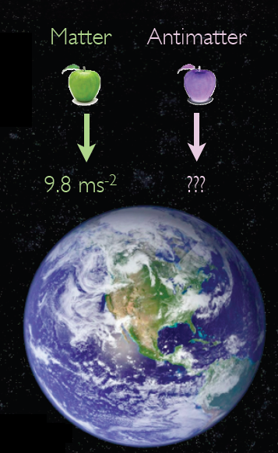
The AEgIS experiment
Akitaka Ariga
Albert Einstein Center for Fundamental physics
Laboratory for High Energy Physics
University of Bern, Switzerland
for the AEgIS collaboration

Slide 2
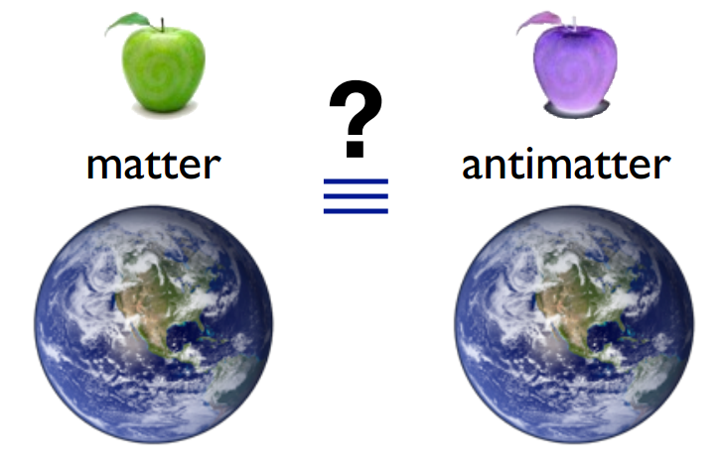
Motivation:
Why study gravity with antimatter?
Principal of equivalence between
gravitational and inertial mass (m_{i}=m_{g})
is a foundation of General Relativity.
General relativity: classical theory
that makes no distinction between
matter and antimatter.
Universality of Free-Fall tested directly to 10⁻¹², but only with matter based experiments.
AEgIS Antimatter Experiment gravity Interferometry Spectroscopy
Test the Universality of Free-Fall with antimatter by measuring the Earth’s gravitational acceleration ( g ) on a beam of antihydrogen.

Slide 3

The AEgIS Collaboration at CERN

Slide 4
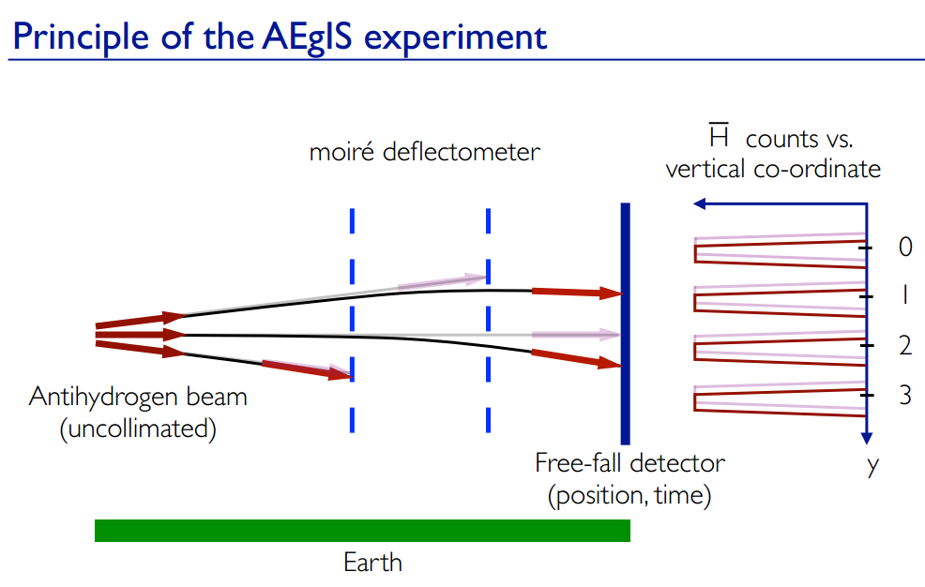
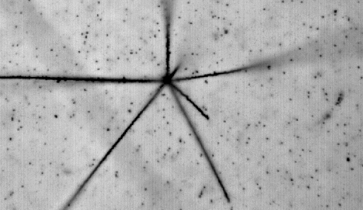

The free-fall is of the order of 10 microns
→ Nuclear emulsion

Slide 5
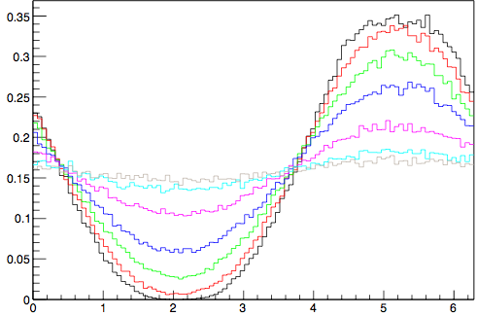
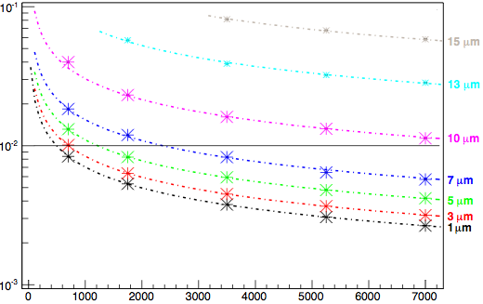







Resolution requirements for a position detector in AEgIS
AEgIS goal: 1% resolution for Δg/g
Emulsion detectors: ~1 µm resolution
velocity = 600 m/s
Δg/g
Relative intensity
phase shift
2π/p* Δx
Phase Φ [rad]
# of detected anti-hydrogen
Emulsions allow to achieve the experiment goal with less than 1000 detected anti-hydrogen atoms

Slide 6
Detection of antimatter annihilation
Atom(matter)
Anti-Hydrogen beam
~10 μm
antimatter
annihilation
detector (matter)
H
20 cm
antimatter
Emission of many particles
Photographic emulsion detectors
3D tracking of particles
High position resolution (50 nm)

Slide 7
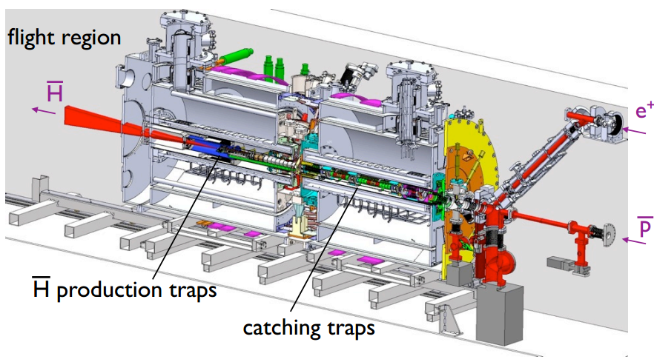
The AEgIS apparatus

Slide 8
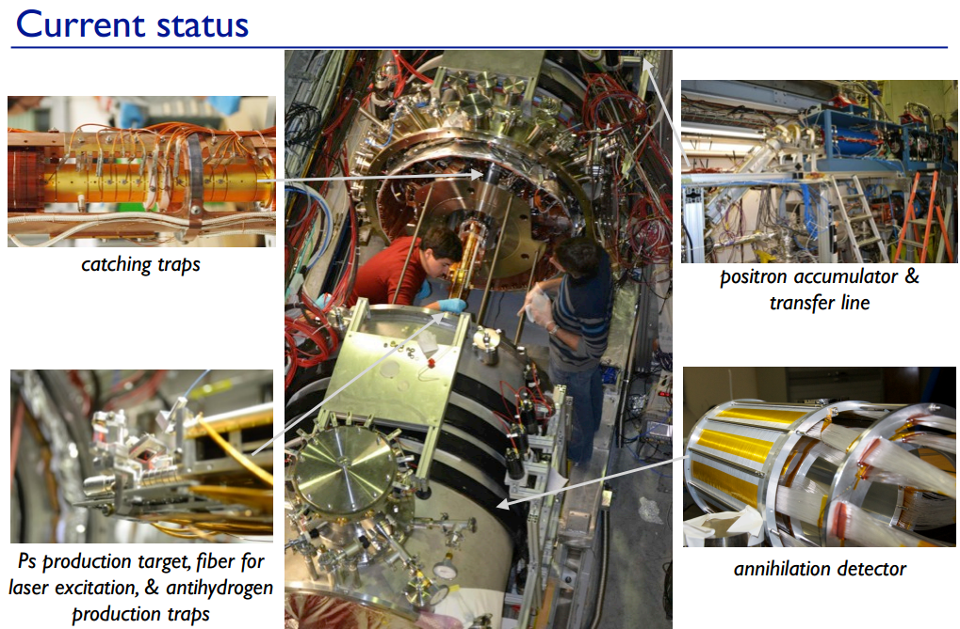

Slide 9
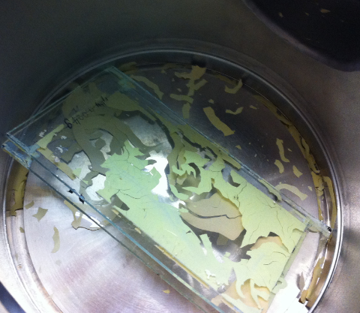
Technical challenges
First test in vacuum → emulsion layer on glass was completely destroyed in vacuum after2 days.
Emulsion in vacuum
  Little previous experience
  Vacuum can damage the emulsion surface
  Increase random noise
  →R&D on vacuum tolerant emulsions
Emulsion in low temperature of 77K
  Little previous experience
Scanning of tracks
  Tracks from antihydrogen -> Low energy, 4π steradian
  Need to develop a dedicated scanning algorithm → see my another talk later

Slide 10
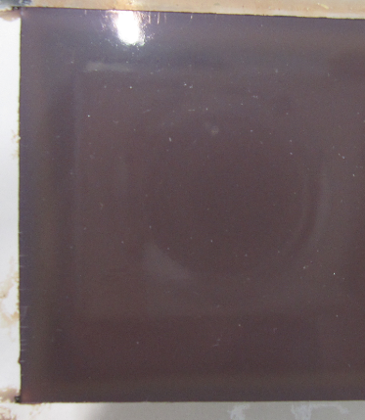
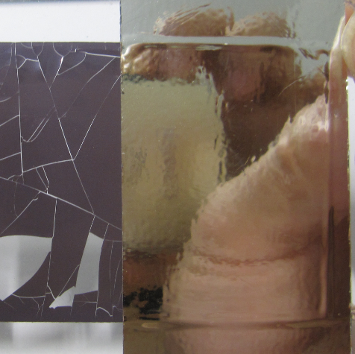
Actions on vacuum problem
Water loss by vacuum leads to emulsion cracks.
Two ways to avoid cracks established
  Mix glycerin with emulsion gel →baseline
    Replace water by glycerin
  Put gas barrier films on emulsions
    Keep water in the films
Glycerin-mixed gel, poured on glass.
No cracks
2. “Aluminum vapor deposition tape”
No cracks

Slide 11
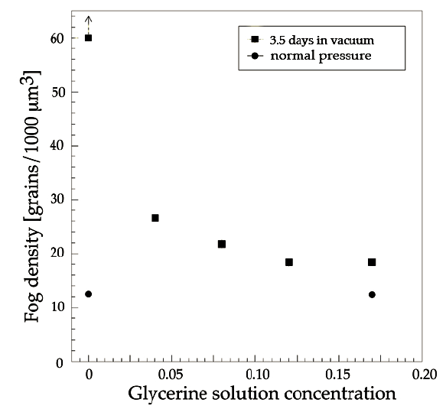
Noise increases in vacuum
Mechanical stress by drying increases random BG (fog)
Fog density measured in films dipped in glycerin solution (normal and vacuum)
Fog density is reduced by adding glycerin
Sample
- OPERA film
- Dipping emulsion for 60 min in
glycerin solution with various
densities (water, 4, 8, 12, 17 %).
After drying, films are kept
in vacuum for 3.5 days.
Normal pressure
JINST 8 (2013) P02015
※Fog density is the number of
background grains per 1000 μm³

Slide 12
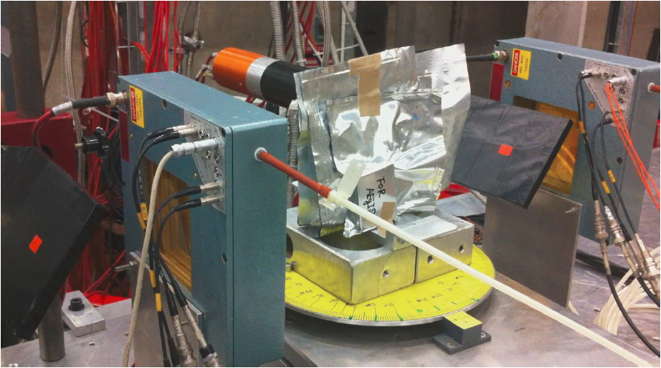
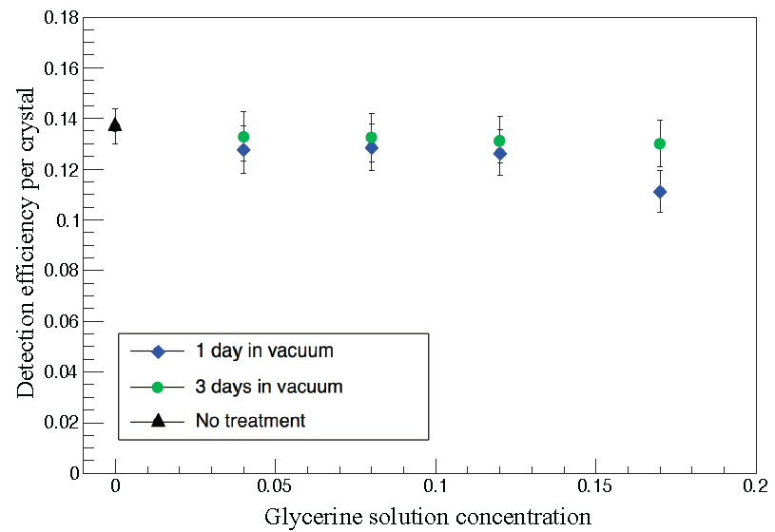
Sensitivity of glycerin-treated films
Sensitivity of glycerin treated films in vacuum by MIP (π⁻ 6 GeV/c, CERN PS/T-10 in Aug 2012).
Films in vacuum for 1 day (down to 10⁻⁵ mbar) or 3 days (10⁻⁶mbar).
Detection efficiency per crystal measured for MIP.
  About 230 crystals along 100 μm in emulsion
No degradation by glycerin content
JINST 8 (2013) P02015
Original = 14 %
π 6 GeV/c

Slide 13
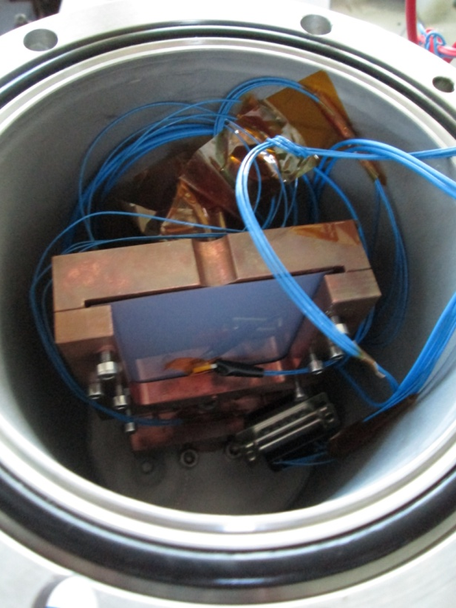
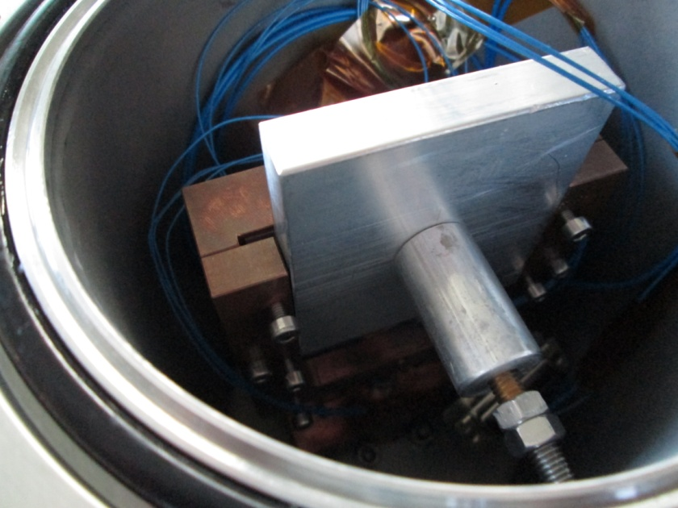
Low temperature test setup
β
a new variable temperature cryostat is constructed to measure the sensitivity as function of temperature.
``Sensitivity” = number of grains along MIPs
Emulsion
ray source
with 2.5 MBq
(⁹⁰Sr, 2.2 MeV)
Vacuum pump
Temerature sensor (Pt100)
PC + Power station
(Temperature
controller)
Aluminum block
for thermal radiation shield
Emulsion
Heater
(25 W x 2)
Cu block
LN2
Cryostat inside

Slide 14
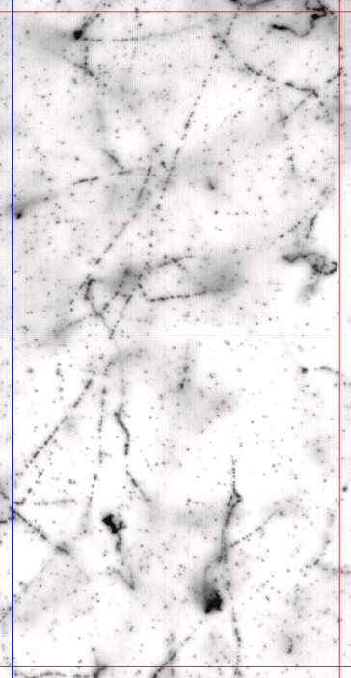
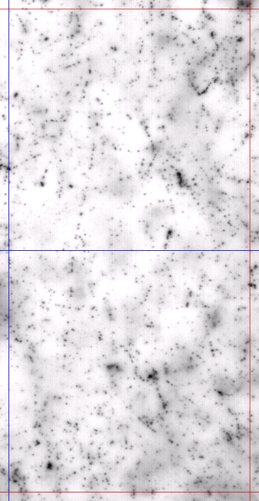
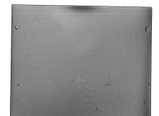
β-ray tracks
298K (room temperature)
79K
β
100
μm
β

Slide 15
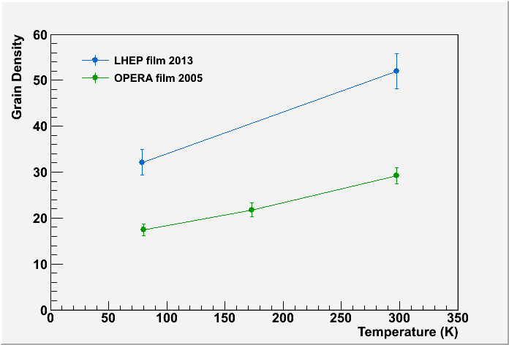
Sensitivity at low temperature
 | Ratio 298K/79K
LHEP | 62%
OPERA | 60%
62% of room temp.
high enough for tracking
79K
More or less linear correlation has been observed.
Sensitivity of LHEP film at 79K is 32 grains/100micron, which is 62% of that at room temperature.
Nevertheless, it is still higher than that of OPERA films at room temperature → reconstruction of MIP particles will be OK.

Slide 16
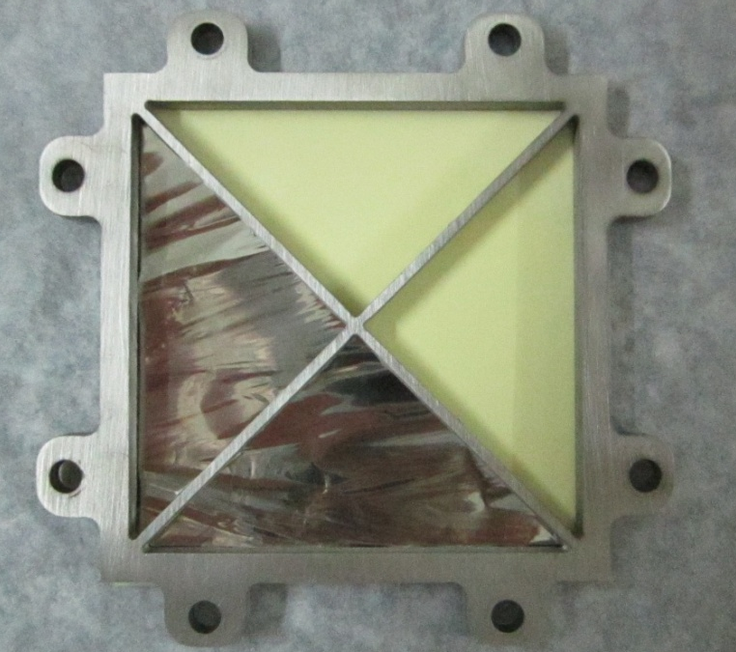
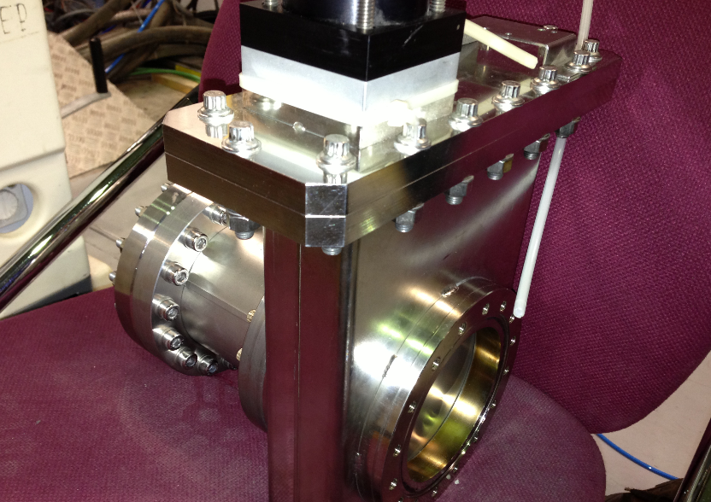
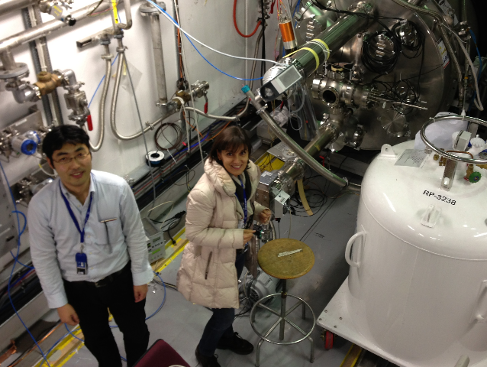
Commissioning in 2012
To Janusz chamber
Gate valve
Emulsion stack here
Exposure procedure
Removal from AD6 (0.5h)
Assemble module in darkroom in CERN
Pumping
(2h)
Exposure (2h)
Disassemble in darkroom
Setting in AD6 (0.5h)
Thanks to reduction of pumping time, 2 exposures became possible in one shift

Slide 17
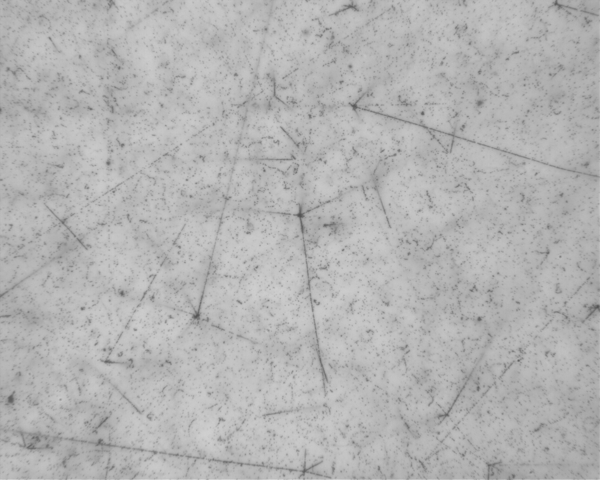
Annihilation events in bare emulsion
50 microns
5000 events /cm²

Slide 18
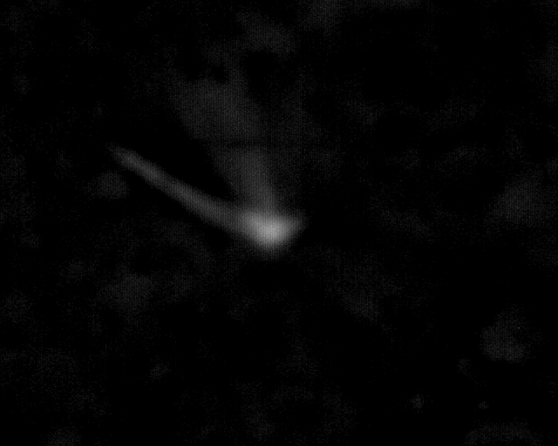
Emulsion view in new gel on glass base
antiproton
Focus
Emulsion layer
(50 micron)
Glass base
1 mm
Emulsion layer
(50 micron)
200 microns
Notes:
C:\Users\ariga\prg\LHEPMic6\work\AEgIS_G1

Slide 19
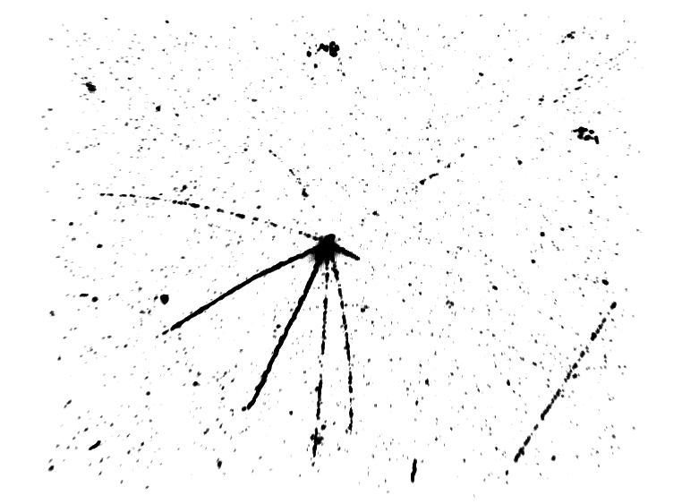
3D view of new gel on glass
150 μm x 120 μm x 50 μm

Slide 20
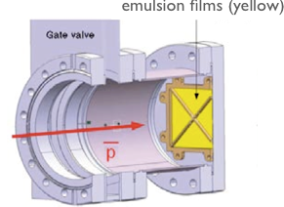
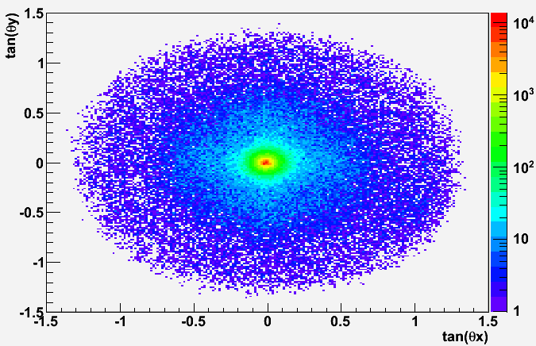
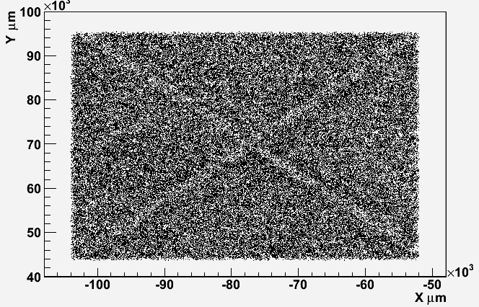
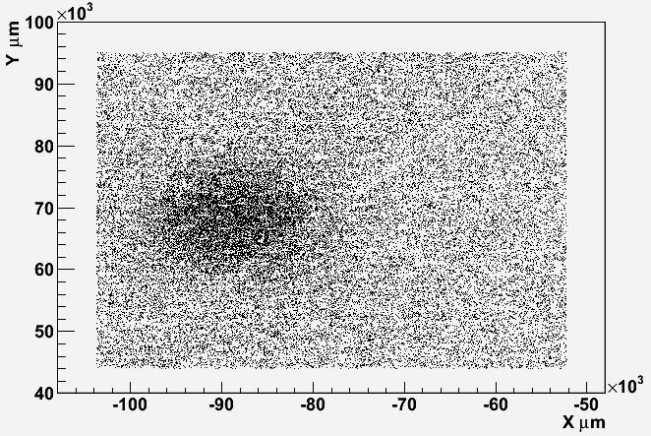
Scanned data
Angular distribution of tracks
OPERA film
(5cm x 5cm)
Peak at angular center
Beam profile tan(θ)>0.1
Beam profile tan(θ)<0.1
5cmx5cm around center.
Mechanical support clearly seen
Beam profile for low angle BG tracks

Slide 21
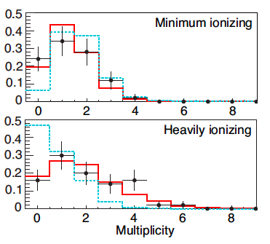
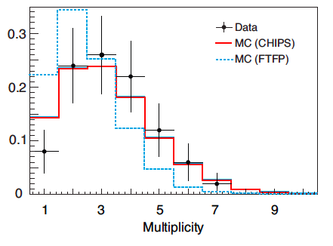
Multiplicity distribution of antiproton annihilation products
JINST 8 (2013) P08013
Data – Monte Carlo comparison
The detection of heavily ionizing tracks allows to discriminate among nuclear models

Slide 22
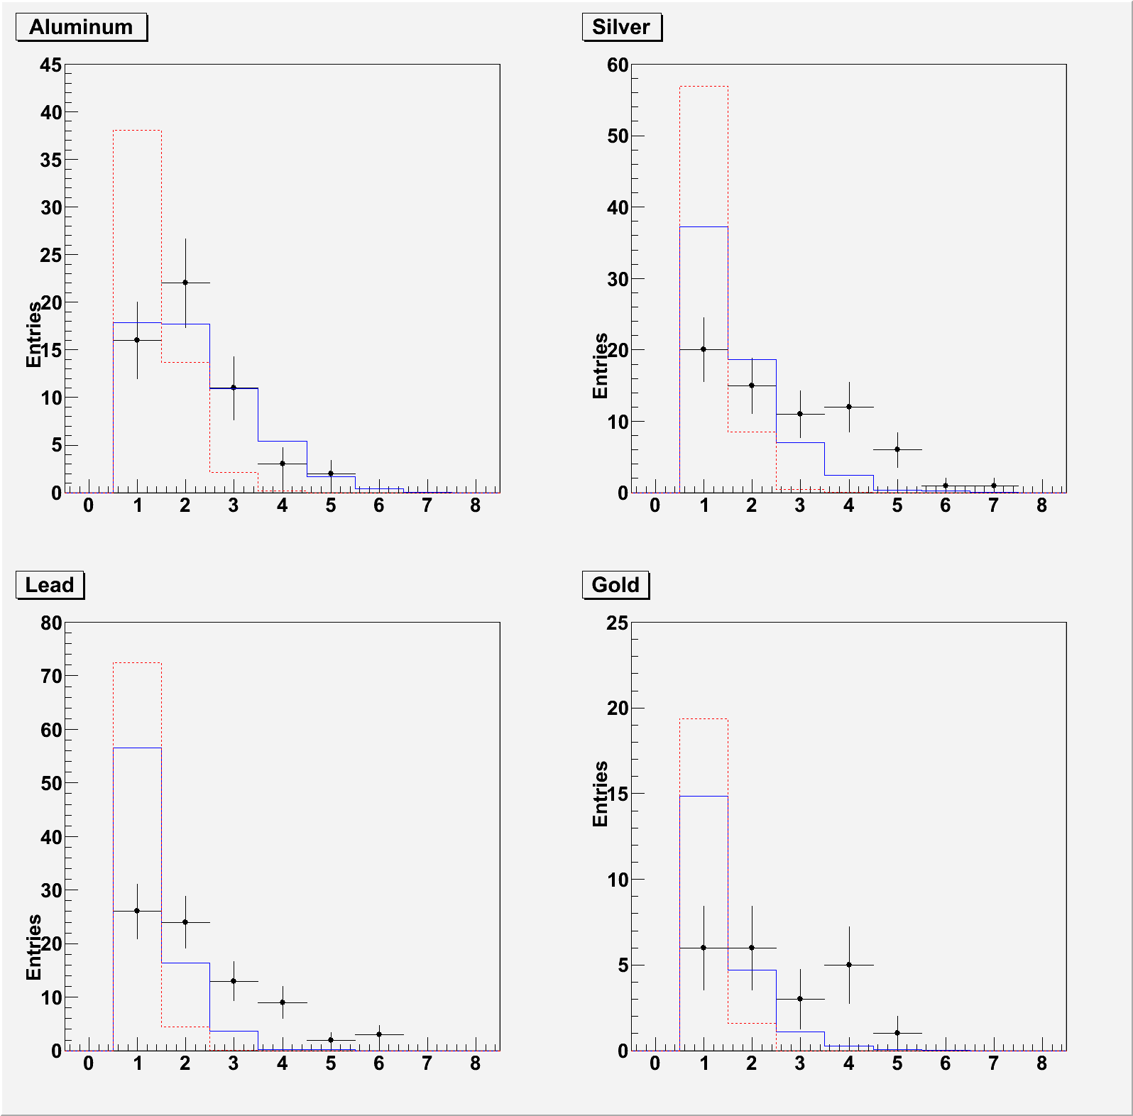
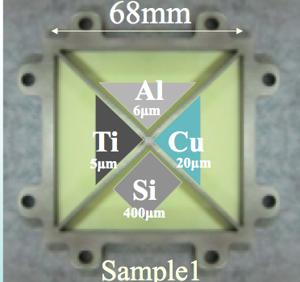
Nuclear fragments in antiproton annihilations
Nuclear fragmentation production in antiproton annihilation is poorly known.
Emulsion films provide a unique possibility to study in detail:
Fragment multiplicity
Dependence on the mass number
Preliminary
Multiplicity of Heavy ionizing tracks
Aluminum
Silver
MC(CHIPS)
MC(CHIPS)
MC(FTFP)
MC(FTFP)
Data
Data
Lead
Gold
MC(CHIPS)
MC(CHIPS)
MC(FTFP)
MC(FTFP)
Data
Data
- Normalized to number of events(data)
- Slope acceptance 0.1 < tanθ < 3.0

Slide 23

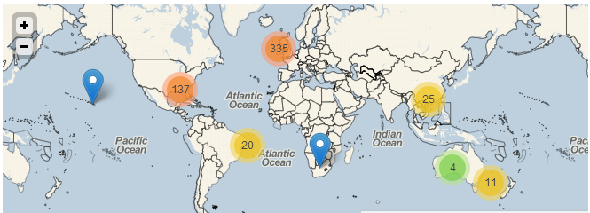
AEgIS for general public
Open opportunity for general public to analyze emulsion data
  amateur physicists with PC and internet can join analysis
Prototype in Aug 2013 for 2 days
  Manual track measurement of 100 views
726 participants from all over the world joined!
  All views were completed
  in a few hours
Need a lot of manual check?
→ Crowdsourcing!
http://home.web.cern.ch/about/updates/2013/08/join-dots-measure-antimatter

Slide 24
Summary
The gravitational force on antimater is a fundamental question in understanding of our universe
The AEgIS experiment is going to measure it for the first time.
Emulsion is employed as the free-fall detector for the high position resolution
  Rich physics byproducts
Many technical challenges
  Emulsion in vacuum OK.
  Emulsion in low temperature OK.
Successful commissioning in 2012
R&D on emulsion is ongoing in 2013, 2014
Physics run in 2015

Slide 25
Some publications
JINST 8 (2013) P02015
JINST 8 (2013) P08013

Slide 26
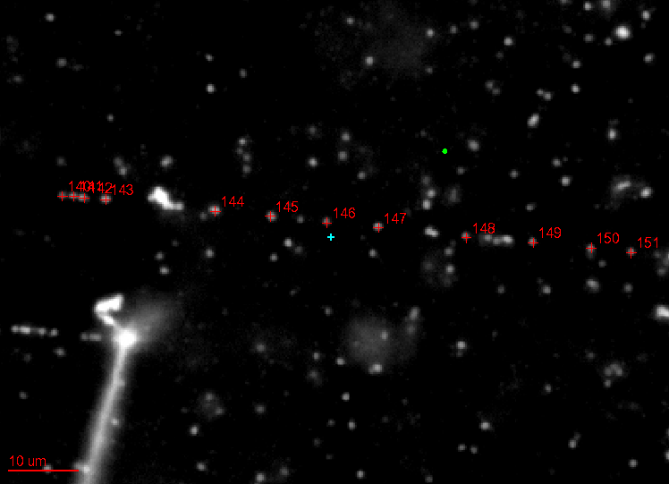
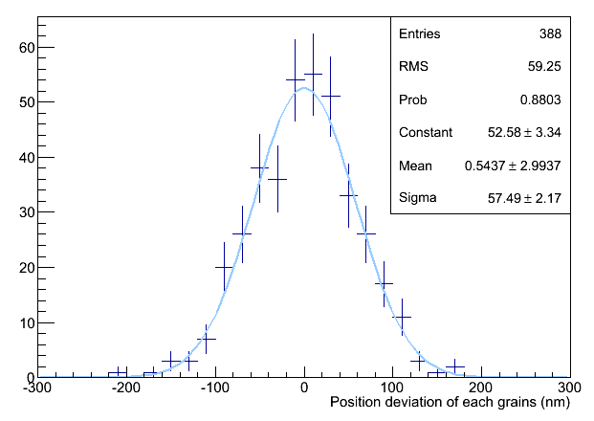
Measurement of intrinsic resolution
Find straight MIP tracks on the display
Click the grains → center of gravity calculation
(Use only grains near to the center of view ← to minimize optical distortion)
(Reject overlapping grains)
Fit a line and evaluate deviation of each grains from the fitted line
Resulting intrinsic resolution = 58nm
This is good, similar to standard film (50nm)
There may be possible contributions
  Measurement error (5nm by x100 objective, 10nm by x50 objective)
  Optical distortion
  Contamination of very short delta-rays (single grain)
  Scattering of the track itself (~ 300 MeV pions)
  Due to glycerin. After glycerin washed away, there might be bigger rooms that silver filaments can grow more freely in the development process

Slide 27
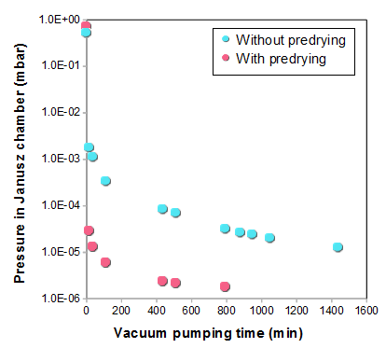
Improvement of evacuation speed by pre-drying
Film pre-dried in vacuum in Bern
- improve detection efficiency by controlling dry level
- shorter vacuum pumping time in Janusz chamber
Pumping time at site
Sample
68 x 68 mm² x 5 films
- Without pre-drying
glycerine density: 17 %
dipping for 60 min
With pre-drying
glycerine density: 12 %
soaking emulsion for 60 min
predrying time: 2 day
June
Dec
1 x 10⁻⁵ mbar

Slide 28
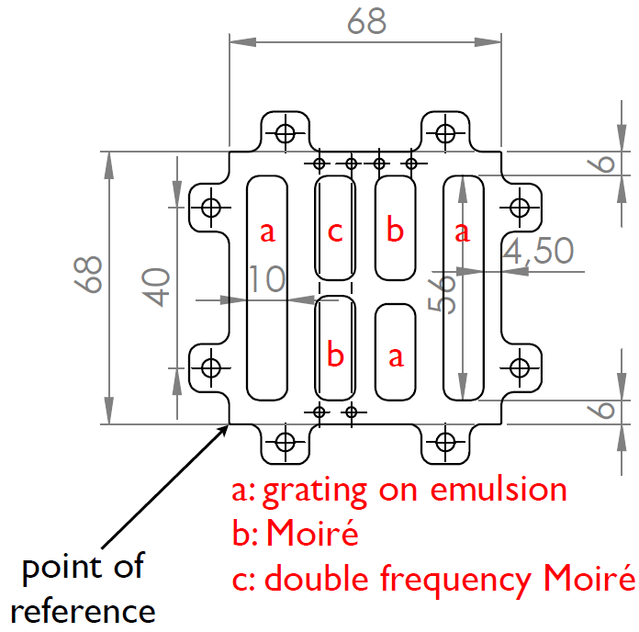
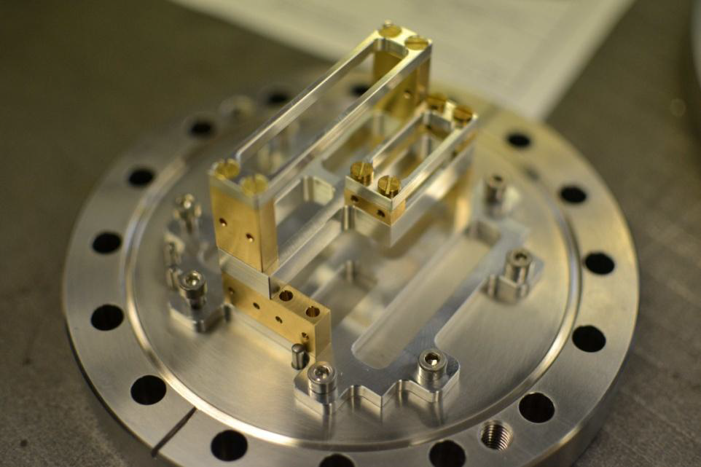
Data taking in mini-moiré sample
Proof of principle
Automatic measurement not used (due to chemical induced BG)
Eye measurement
  In (b) region with 2 moiré gratings
  47 vertices detected in 3 hours within 0.16 cm²
(2 gratings)

Slide 29
Emulsion on glass base
Minimize systematics from expansion of emulsions
Smaller expansion factor (measured)
  Plastic base: 11 μm/cm
  Glass base: less/equal 0.4 μm/cm
Smaller thermal expansion
Production and test of emulsions on glass ongoing
 | Thermal expansion coefficient ( /K)
Acrylic | ~ 10⁻⁴
Glass | ~ 5x10⁻⁶

Slide 30
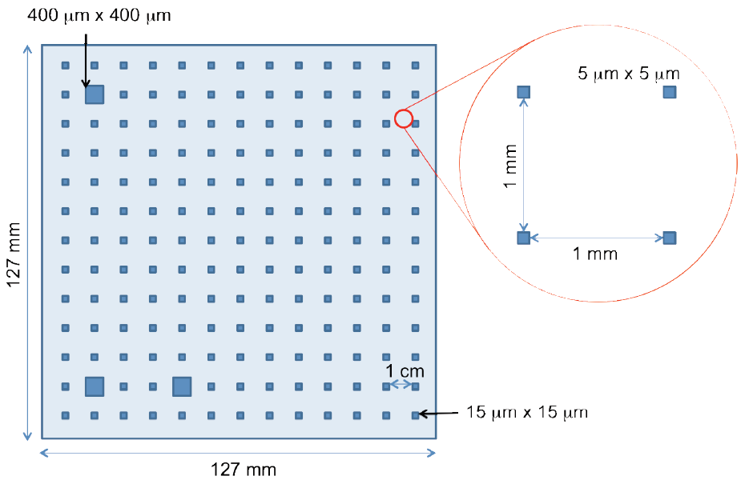
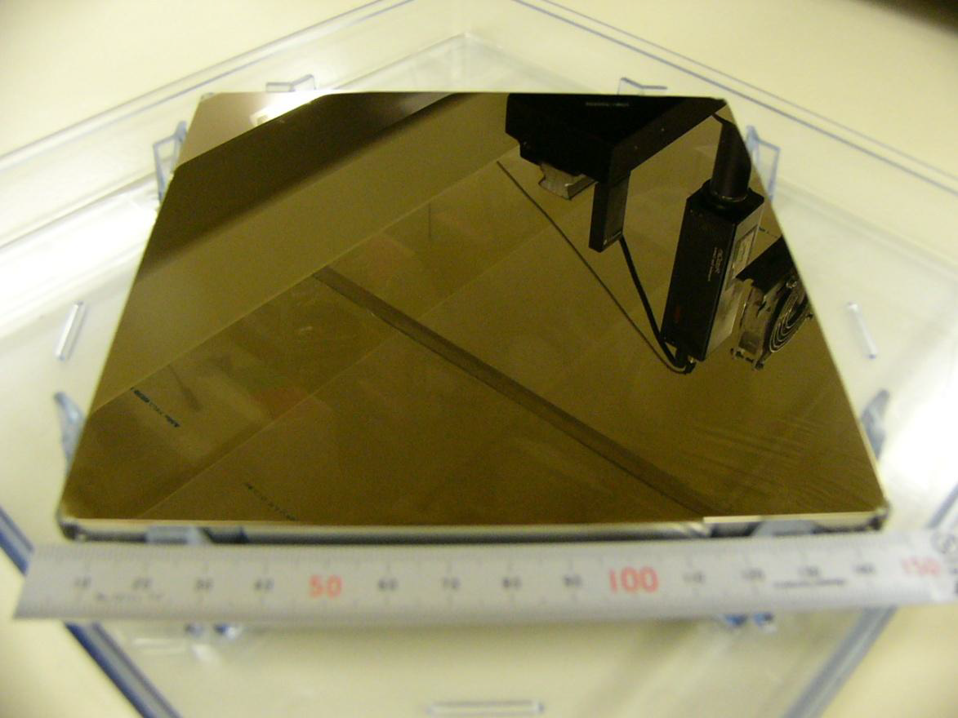
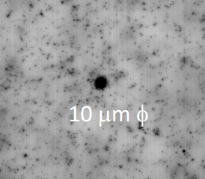
Study of film expansion
Emulsion film can change its size after photo-development
Pattern of marks printed on OPERA films by photo-mask
Photo-mask
Emulsion view
A dot is printed every 1 mm.

Slide 31
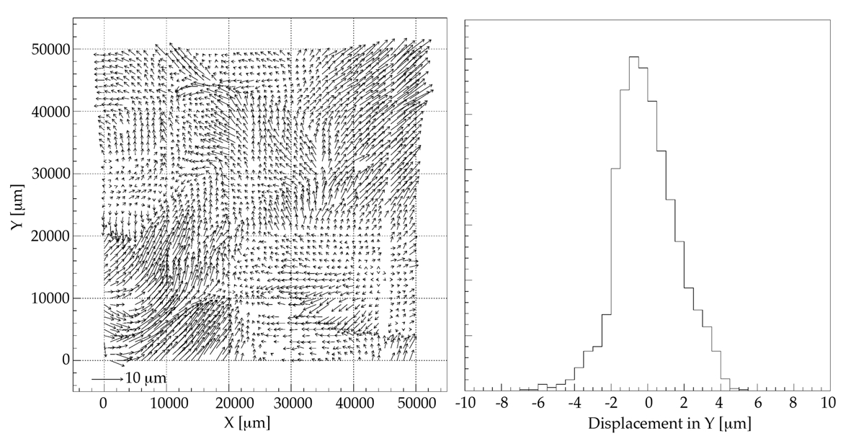
Measured expansion pattern
Measured expansion factor is 11 μm/cm
Local displacement from photo mask and emulsion shown as arrows
Local displacement under control (1 μm) by photo-mask patterns
More rigid base (glass) instead of plastic base
5cm
Effect is of the order of a few microns.

Slide 32

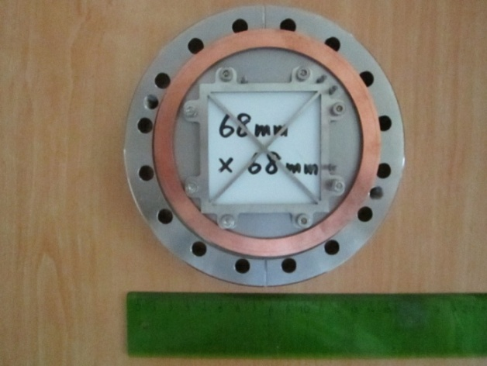
Detector setup
(also in December)
Emulsion : (68 mm x 68 mm x 0.3 mm) x 5 films
Target : stainless steel (SUS) 20 μm thick / bare emulsion.
Bare emulsion
UVC/OVC separation
(2 μm titanium foil)
SUS 20 μm
p
Janusz chamber
(10⁻⁵ mbar)
SUS 20 μm
Main gate valve
Flange
Gate valve
5 T magnet
Emulsion (5 films)
turbo pump
turbo pump
Emulsion holder
Emulsion holder

Slide 33
Heavy ionizing tracks multiplicity
MC(CHIPS model) comparison
Multiplicity of Heavy ionizing tracks
Require at least 1 thin track,
and 1 heavy track
Aluminum
Silver
MC(CHIPS)
MC(CHIPS)
MC(FTFP)
MC(FTFP)
vertex
Data
Data
1
3
Heavy track
2
thin track
Vertex location is done by 1 thin track
and 1 heavy track.
→ Then, all heavy tracks were counted.
Lead
Gold
MC(CHIPS)
MC(CHIPS)
MC(FTFP)
MC(FTFP)
Here in MC simulation,
-100% efficiency for heavy ionizing
tracks is assumed.
-Heavy ionizing means dE/dX>2.0MeV/[g/cm²]
Data
Data
- Normalized to number of events(data)
- Slope acceptance 0.1 < tanθ < 3.0
11

Slide 34
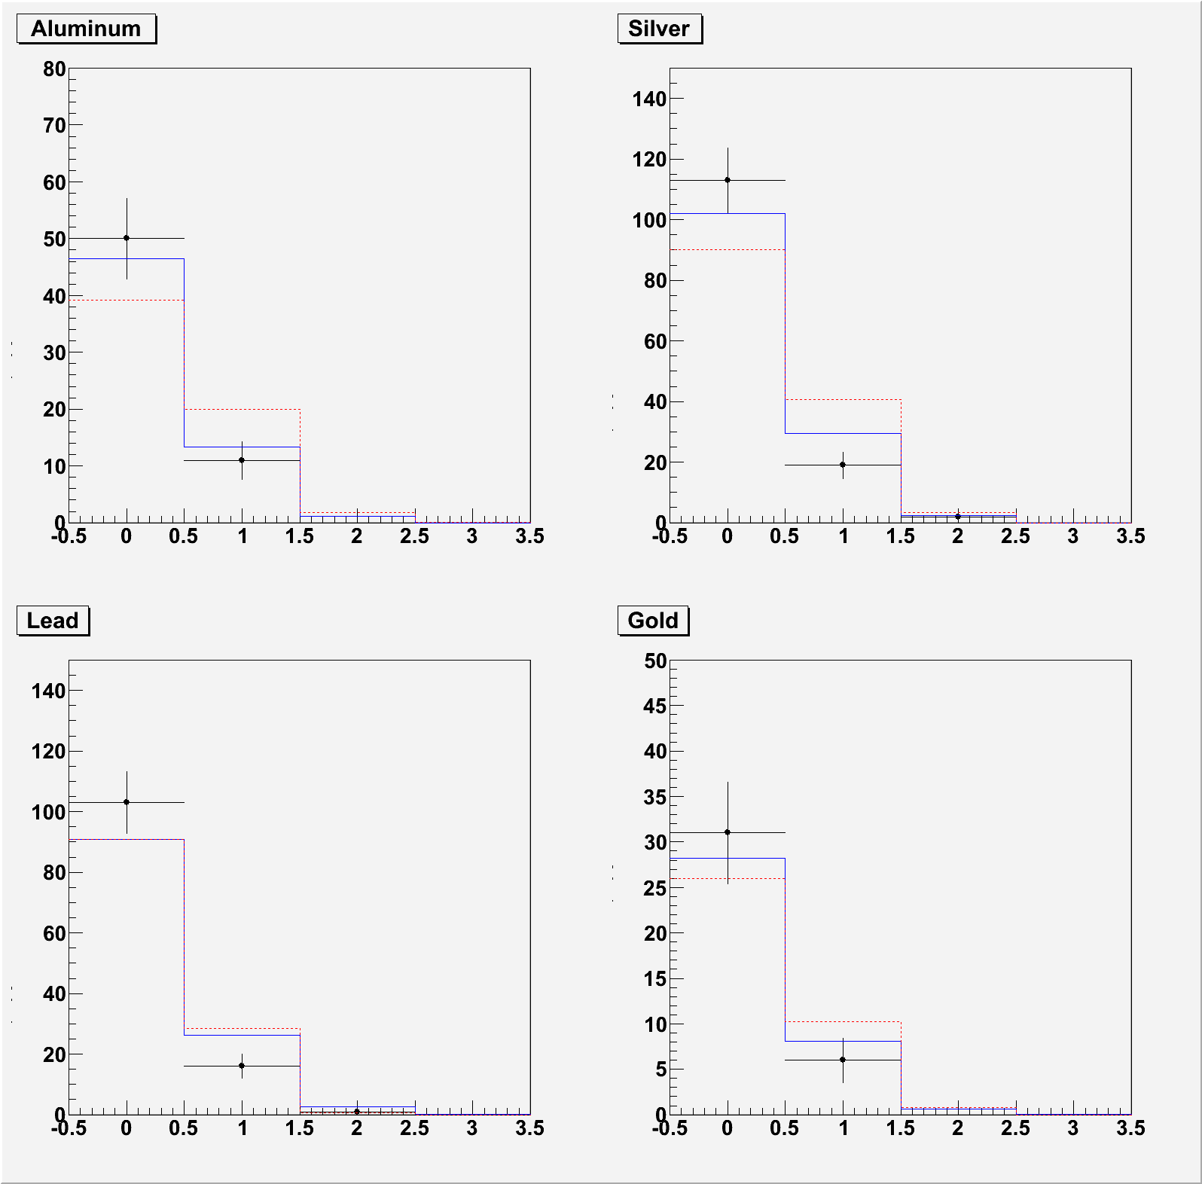
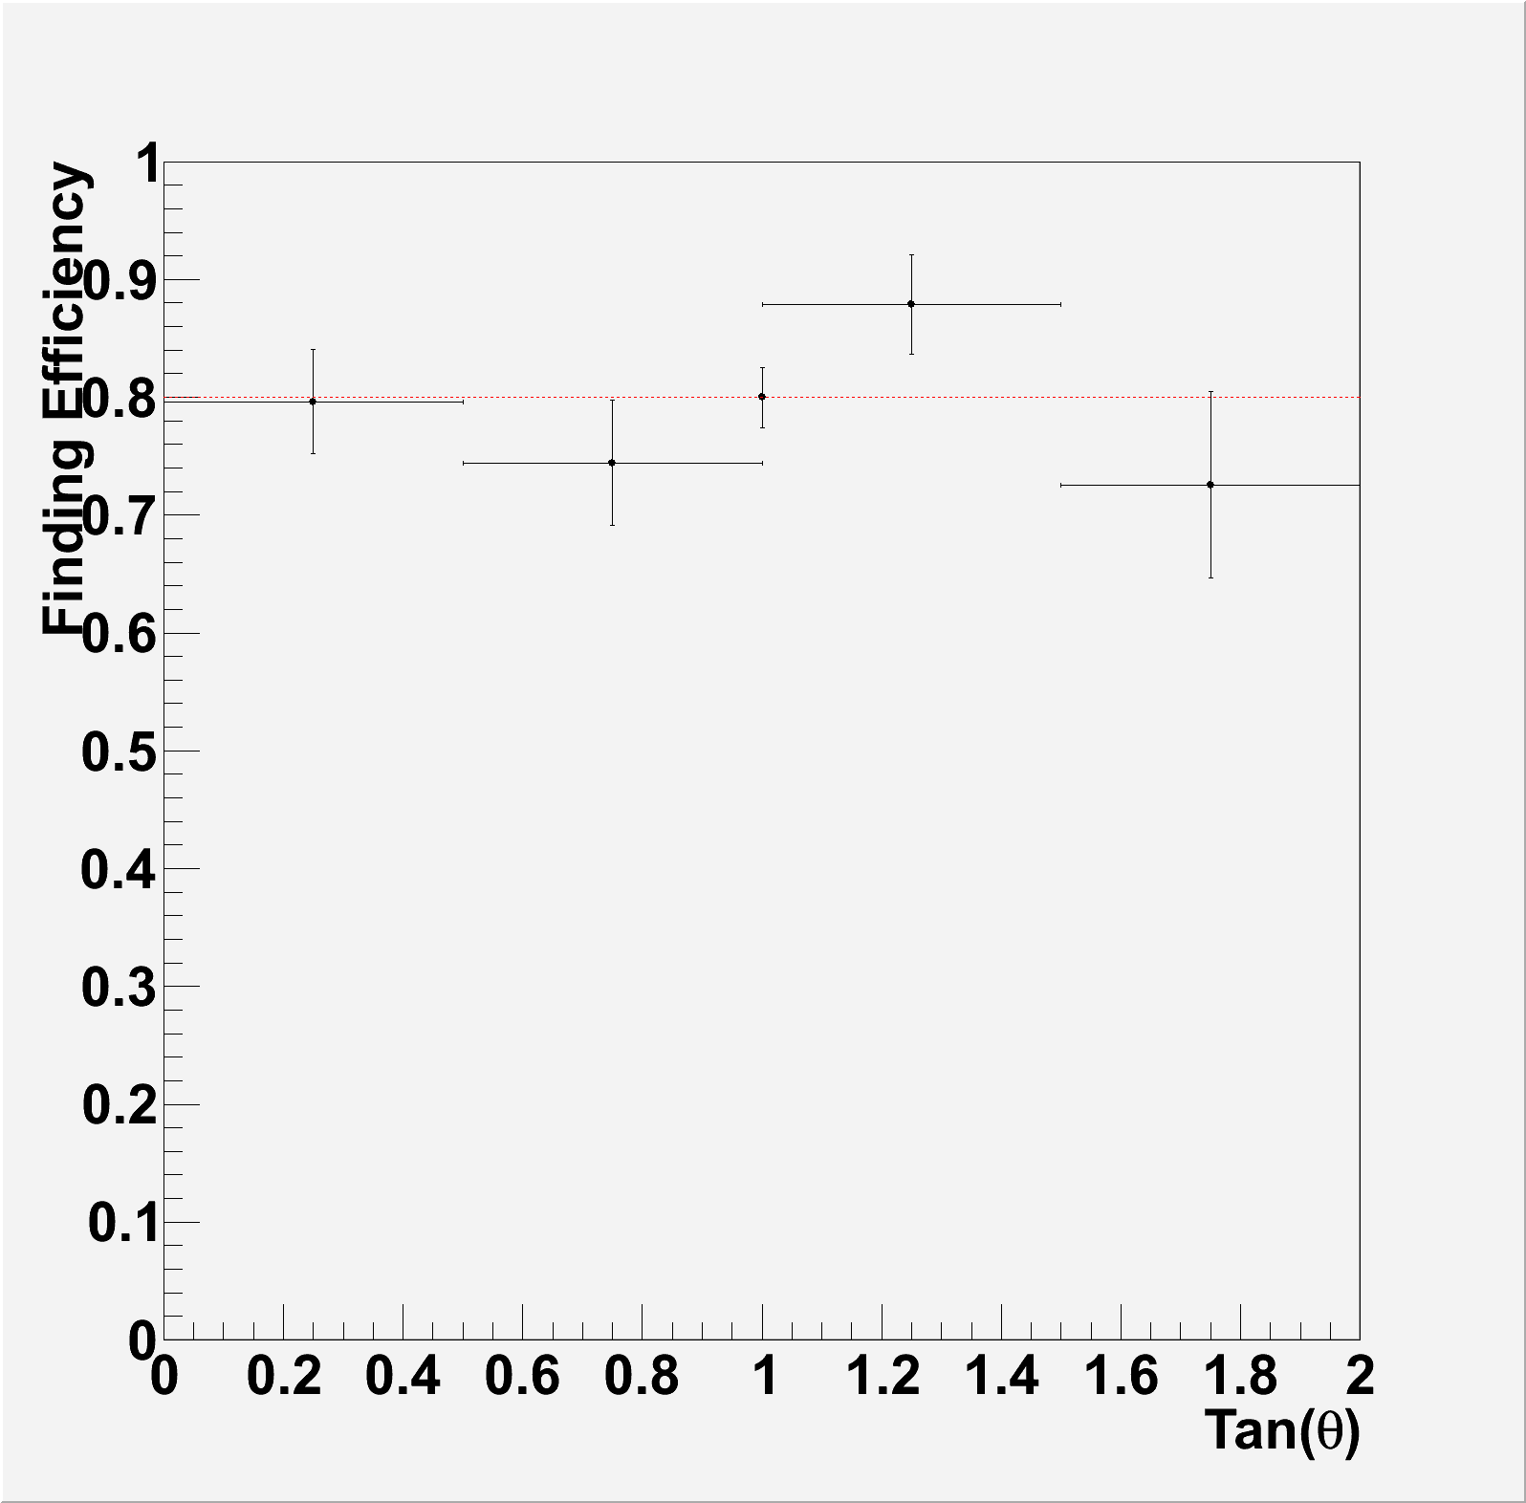
Minimum ionizing tracks multiplicity
MC(CHIPS model) comparison
Multiplicity of Minimum ionizing tracks
- Require at least 2 heavy track
vertex
Aluminum
Silver
MC(CHIPS)
MC(CHIPS)
MC(FTFP)
MC(FTFP)
Heavy track
Heavy track
Data
Data
1
2
Vertex location is done by heavy tracks.
Then, all MIP tracks were counted.
MIP track finding efficiency
Lead
Gold
MC(CHIPS)
MC(CHIPS)
MC(FTFP)
MC(FTFP)
Data
Data
Overall efficiency
0.800±0.025
Took into account in MC
- Normalized to number of events(data)
- Slope acceptance 0.1 < tanθ < 3.0
13

Slide 35
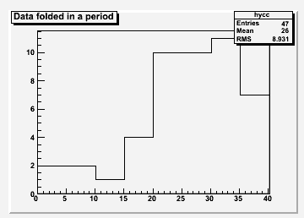
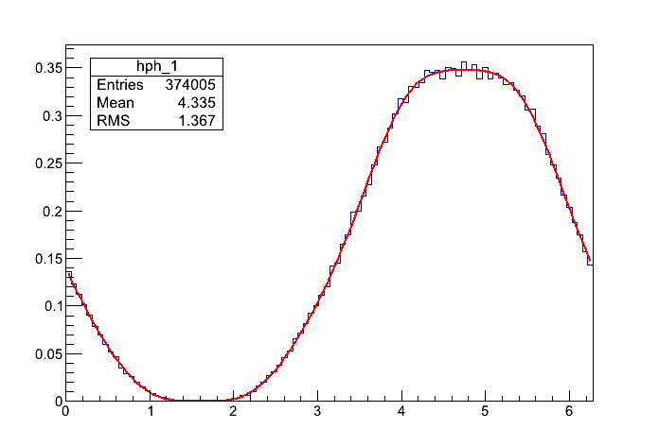
Data folded in period
(after rotation and expansion correction)
MC (from C. Pistillo)
(rad)
period
Y folded in a pitch (μm)

Slide 36
Emulsion for in the AEgIS
Use emulsions as position detector
TOF
Emulsion
Moire slits
Antihydrogen
Ideal position resolution down to a few microns.
Emulsion to be placed in OVC
OVC
UHV
TOF
H
Emulsion
Thin window (~0.1mm)
(Metal foil or Si tracker)

Slide 37
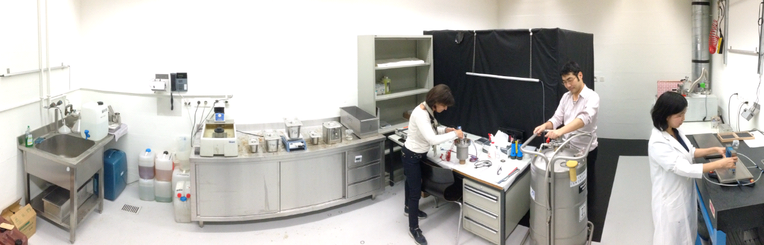

Setup at LHEP, Bern
Dedicated laboratory 30 m underground
Low temperature tests for emulsion is now continued in Bern

Slide 38



Annihilations vertex resolution
Vertex resolution
Vertex resolution perpendicular to the emulsion surface
1 μm rms resolution on the vertical position of the annihilation vertex is achievable
Bare emulsion
Steel foil

Slide 39

Topography of the emulsion and stainless steel foil
Bare emulsions
Emulsions + stainless foil
stainless steel foil
p
p

